Slide 1
Accreditation of joint programmes: the new European Approach
Dr Mark Frederiks
NVAO & ECA
25 February 2016, Leiden
14 March 2011

Slide 2
Current status regarding accreditation of joint programmes
Joint programmes are confronted with different national QA regimes: fragmented assessments, multiple procedures, frameworks, visits, panels, reports
Decisions only have an influence on national system
JOQAR project (2010-2013) of ECA showed possible solution; single procedure and mutual recognition
European Approach for Quality Assurance of Joint Programmes; adopted in May 2015 by EHEA Ministers in Yerevan
No experiences yet but first applications forthcoming

Slide 3
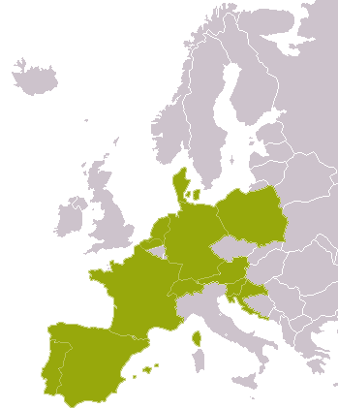
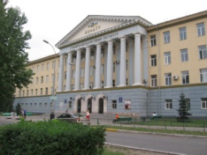
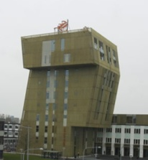
Single procedure tested in JOQAR
Single procedure
Procedure by:
One agency
Focus of procedure
Whole joint programme
Result:
National accreditations in countries of JP consortium

Slide 4
Additional national criteria problematic (Source: ECA’s JOQAR project)
Too many national criteria and national requirements in external QA/accreditation of joint programmes
Sometimes not about quality
Not suited for joint programmes
Contradict each other
Very long list of examples:
The assessment report (expert report) is required to be in the national language;
National QA agencies which are not allowed to coordinate an international procedure / undertake a site visit abroad;
Master thesis: “max. 30 ECTS credits” vs. “at least 35% of the total number of credits”;
Very detailed, national staff requirements
…

Slide 5
The way forward
Bucharest Communique (2012):
„we will aim to recognise quality assurance decisions of EQAR-registered agencies on joint and double degee programmes“
This led to European Approach for QA of Joint Programmes

Slide 6
European Approach for QA of JPs
Background report (context, current QA practices, lessons learnt from ECA’s JOQAR project)
European Approach:
Introduction and definitions
A. Application in Different Systems of External QA
B. Standards for QA of Joint Programmes
C. Procedure for External QA of Joint Programmes
Note: B and C are in line with European Standards and Guidelines for QA in EHEA (ESG)
Adopted by EHEA Ministers in Yerevan,14-15 May 2015

Slide 7
ESG Part 1. Standards and guidelines for internal quality assurance
1.1 Policy for quality assurance
1.2 Design and approval of programmes
1.3 Student-centred learning, teaching and assessment
1.4 Student admission, progression, recognition and certification
1.5 Teaching staff
1.6 Learning resources and student support
1.7 Information management
1.8 Public information
1.9 On-going monitoring and periodic review of programmes
1.10 Cyclical external quality assurance

Slide 8
Definitions in EA
Joint programme: An integrated curriculum coordinated and offered jointly by different HEIs from EHEA countries and leading to a double/multiple degrees or a joint degree
Double/Multiple degrees: Separate degrees awarded by HEIs offering the joint programme attesting the successful completion of this programme
(If 2 degrees are awarded by 2 institutions, this is a „double degree“)

Slide 9
Definitions in EA
Joint degree: A single document awarded by HEIs offering the joint programme and nationally acknowledged as the recognised award of the joint programme

Slide 10
Essence of European Approach
European standards and procedure
Standards and procedure according to ESG, taking “jointness” into account
Decision/result
“Setting standards…based on the agreed tools of the EHEA, without applying additional national criteria”
By EQAR-listed agency
No additional national criteria!
Accepted in other EHEA countries by other agencies

Slide 11
A. Application in Different Systems of External QA
If some of cooperating HEIs require programme accreditation/evaluation then HEIs should select a QA agency registered in EQAR
Now 42 agencies listed in EQAR: www.eqar.eu
All of these agencies have been externally evaluated to be compliant with ESG
Agency will use Standards and Procedure to carry out a single procedure of the entire joint programme; the decision to be recognised in all countries where the programme is offered
European Approach may be used by self-accrediting HEIs and countries outside of EHEA

Slide 12
Standards in the European Approach
Eligibility
Learning Outcomes
Study Programme
Admission and Recognition
Learning, Teaching and Assessment
Student Support
Resources
Transparency and Documentation
Quality Assurance

Slide 13
Standards in the European Approach
Eligibility
1.1 Status
The institutions that offer a joint programme should be recognised as higher education institutions by the relevant authorities of their countries. Their respective national legal frameworks should enable them to participate in the joint programme and, if applicable, to award a joint degree. The institutions awarding the degree(s) should ensure that the degree(s) belong to the higher education degree systems of the countries in which they are based.

Slide 14
Understanding the legal issues
Meanwhile in almost all European countries legislation allows HEIs to set up joint degrees
Problems on practical level remain (signing the degrees, paper to print degrees...)
In different countries there are different legal consequences resulting from accreditation (decision by Ministry required based on report vs. programme is automatically authorized to run by Ministry)
Sometimes legal issues are checked in accreditation procedure because the counry has no other checks for this (number and qualification of staff, equal opportunity regulations...)

Slide 15
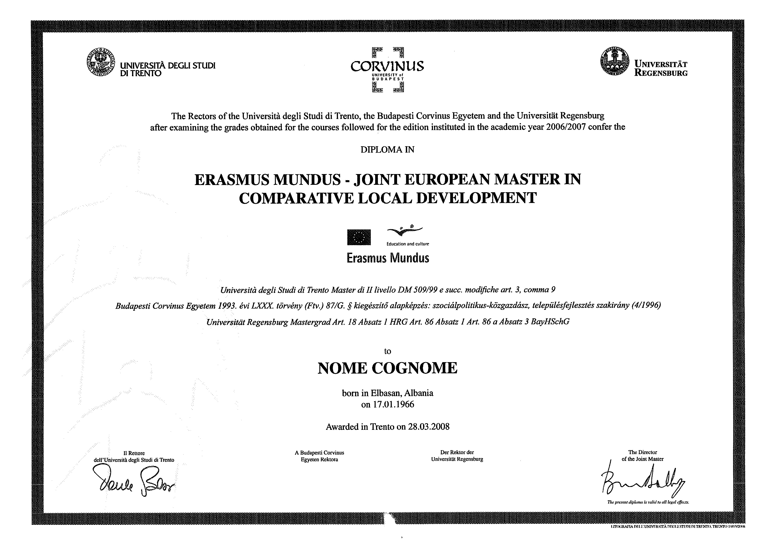
Joint degree: example
Single document
Signed by the competent authorities of the institutions involved in the joint programme
Replaces the separate (institutional/national) degrees

Slide 16
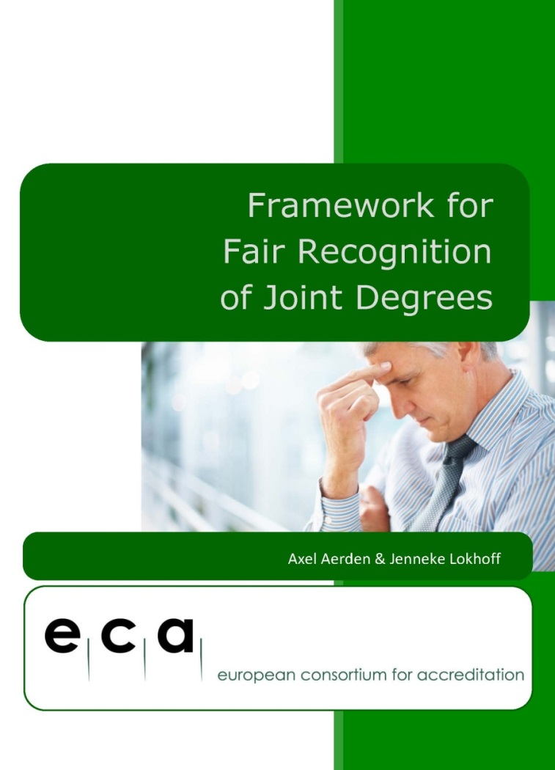
Overcoming challenges on recognition of joint degrees
Guidelines for Good Practice for Awarding Joint Degrees
Useful for HEIs
Framework for Fair Recognition of Joint Degrees
Useful for recognition authorities

Slide 17
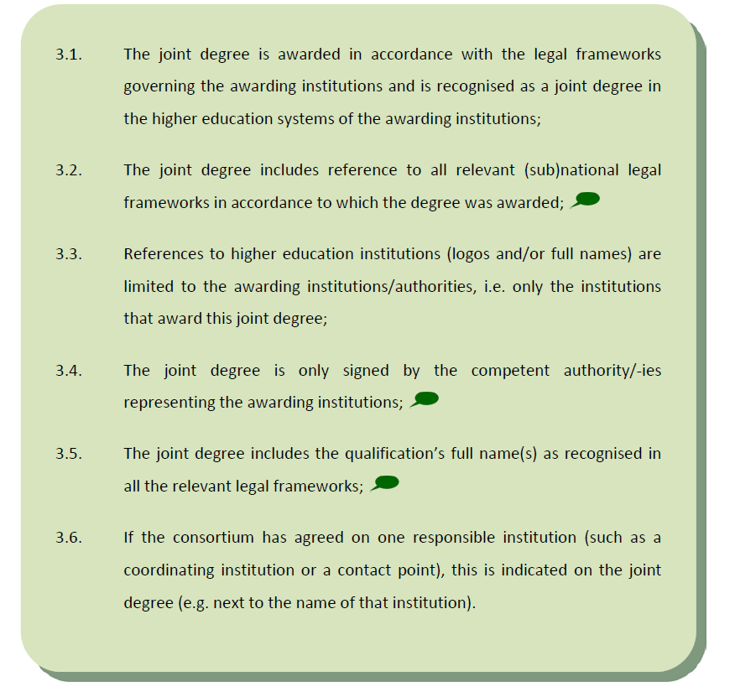
Guidelines for Good Practice for Awarding Joint Degrees

Slide 18
Guidelines not clear?
- Examples can help…

Slide 19
Standards in the European Approach
1. Eligibility
1.2 Joint design and delivery
The joint programme should be offered jointly, involving all cooperating institutions in the design and delivery of the programme.

Slide 20
Standards in the European Approach
1. Eligibility
1.3 Cooperation Agreement
The terms and conditions of the joint programme should be laid down in a cooperation agreement. The agreement should in particular cover the following issues:
- Denomination of the degree(s) awarded in the programme
- Coordination and responsibilities of the partners involved regarding management and financial organisation (including funding, sharing of costs and income etc.)
- Admission and selection procedures for students
- Mobility of students and teachers
- Examination regulations, student assessment methods, recognition of credits and degree awarding procedures in the consortium

Slide 21
Standards in the European Approach
2. Learning Outcomes
2.1 Level [ESG 1.2]
The intended learning outcomes should align with the corresponding level in the Framework for Qualifications in the European Higher Education Area (FQ-EHEA), as well as the applicable national qualifications framework(s).
2.2 Disciplinary field
The intended learning outcomes should comprise knowledge, skills, and competencies in the respective disciplinary field(s).

Slide 22
Standards in the European Approach
2. Learning Outcomes
2.3 Achievement [ESG 1.2]
The programme should be able to demonstrate that the intended learning outcomes are achieved.
2.4 Regulated Professions
If relevant for the specific joint programme, the minimum agreed training conditions specified in the European Union Directive 2005/36/EC, or relevant common trainings frameworks established under the Directive, should be taken into account.

Slide 23
Standards in the European Approach
3. Study programme (ESG 1.2)
3.1 Curriculum
The structure and content of the curriculum should be fit to enable the students to achieve the intended learning outcomes.
3.2 Credits
The European Credit Transfer System (ECTS) should be applied properly and the distribution of credits should be clear.

Slide 24
Standards in the European Approach
3. Study programme (ESG 1.2)
3.3 Workload
A joint bachelor programme will typically amount to a total student workload of 180-240 ECTS-credits; a joint master programme will typically amount to 90-120 ECTS-credits and should not be less than 60 ECTS-credits at second cycle level (credit ranges according to the FQ-EHEA); for joint doctorates there is no credit range specified.
The workload and the average time to complete the programme should be monitored.

Slide 25
Standards in the European Approach
4. Admission and Recognition [ESG 1.4]
4.1. Admission
The admission requirements and selection procedures should be appropriate in light of the programme’s level and discipline.
4.2. Recognition
Recognition of qualifications and of periods of studies (including recognition of prior learning) should be applied in line with the Lisbon Recognition Convention and subsidiary documents.

Slide 26
Standards in the European Approach
5. Learning, Teaching and Assessment [ESG 1.3]
5.1 Learning and teaching
The programme should be designed to correspond with the intended learning outcomes, and the learning and teaching approaches applied should be adequate to achieve those. The diversity of students and their needs should be respected and attended to, especially in view of potential different cultural backgrounds of the students.

Slide 27
Standards in the European Approach
6. Student Support [ESG 1.6]
The student support services should contribute to the achievement of the intended learning outcomes. They should take into account specific challenges of mobile students.

Slide 28
Standards in the European Approach
7. Resources [ESG 1.5 & 1.6]
7.1 Staff
The staff should be sufficient and adequate (qualifications, professional and international experience) to implement the study programme.
7.2 Facilities
The facilities provided should be sufficient and adequate in view of the intended learning outcomes.

Slide 29
Standards in the European Approach
8. Transparency and Documentation [ESG 1.8]
Relevant information about the programme like admission requirements and procedures, course catalogue, examination and assessment procedures etc. should be well documented and published by taking into account specific needs of mobile students

Slide 30
Standards in the European Approach
9. Quality Assurance [ESG 1.1 & part 1]
The cooperating institutions should apply joint internal quality assurance processes in accordance with part one of the ESG.

Slide 31
The procedure according to the European Approach
Self-Evaluation Report
Review Panel
Site Visit
Review Report
Formal Outcomes and Decision
Appeals
Reporting
Follow-Up
Periodicity

Slide 32
The procedure according to the European Approach
The cooperating institutions should jointly select a suitable EQAR-registered quality assurance agency.
The agency should communicate appropriately with the competent national authorities of the countries in which the cooperating higher education institutions are based.

Slide 33
The procedure according to the European Approach
1. Self-Evaluation Report [ESG 2.3]
Jointly submitted by the cooperating HEIs.
Should contain comprehensive information that demonstrates the compliance of the programme with the Standards.
Necessary information about the respective national frameworks of the cooperating HEIs to understand the context/national positioning of the programme
Focus explicitly on the distinctive feature of the joint programme as a joint endeavour of HEIs from more than one national higher education system.

Slide 34
The procedure according to the European Approach
2. Review Panel [ESG 2.3 & 2.4]
At least 4 panel members; expertise in relevant subject(s), including labour market, QA expertise
International expertise and experience. Collectively, knowledge of the HE systems of the HEIs involved and the language(s) of instruction. At least 2 countries involved in the consortium
At least one student.
Impartiality and fairness; HEIs may object against a panel member, but have no veto right
The agency should brief the experts on review activity, role, specifics of a joint programme.

Slide 35
The procedure according to the European Approach
3. Site Visit [ESG 2.3]
Should enable the review panel to discuss the joint programme based on SER and assess whether the programme complies with the Standards
The site visit should therefore include discussions with representatives of all HEIs; management HEIs and JP, staff, students, alumni, professional field.
Although the site visit should normally be restricted to one location, the provision at all locations has to be taken into account.

Slide 36
The procedure according to the European Approach
4. Review Report [ESG 2.3 & 2.6]
Should contain evidence, analysis and conclusions with regard to the Standards.
Should contain recommendations for developing the programme further.
Panel should make recommendation for decision.
The conclusions and recommendations should pay particular attention to the distinctive features of the joint programme.
The institutions should have the opportunity to comment on a draft version of the review report and request correction of factual errors.

Slide 37
The procedure according to the European Approach
5. Formal Outcomes and Decision [ESG 2.5]
Agency should take a decision on the basis of the review report and the recommendation for the decision, considering the comments by HEIs as appropriate.
In case the review results in an accreditation decision, it grants or denies the accreditation (with or without conditions), based on the Standards
The agency may supplement the formal outcome and the accreditation decision by recommendations.
The agency should give reasons for its accreditation decision.

Slide 38
The procedure according to the European Approach
6. Appeals [ESG 2.7]
The institutions should have the right to appeal against a formal outcome or an accreditation decision. Therefore, the agency should have a formalised appeals procedure in place.

Slide 39
The procedure according to the European Approach
7. Reporting [ESG 2.6]
The agency should publish the review report and, if applicable, the formal outcome or the accreditation decision on its website.
At least an English summary of the review report and an English version of the decision, including its reasons, should be published.

Slide 40
The procedure according to the European Approach
8. Follow-up [ESG 2.3]
The agency should agree with the cooperating institutions a follow-up procedure to assess the fulfilment of conditions – if applicable – and/or to evaluate the follow-up actions on recommendations – if applicable.

Slide 41
The procedure according to the European Approach
9. Periodicity [ESG 1.10]
The joint programme should be reviewed periodically every 6 years. If there is a positive accreditation decision it should be granted – if the decision is positive – for a period of 6 years. During the 6-year period, agency should be informed about changes in the consortium offering the joint programme.

Slide 42
Implementation challenges European Approach
Lack of awareness among HEIs (and QA agencies, Ministries, students, employers)
Lack of information on how many JPs fall under the remit of the European Approach
Legal and recognition challenges
Operational/procedural challenges

Slide 43
Overcoming implementation challenges
Dissemination and promotion of EA to all stakeholders
Better information on JPs needed (role for JPs/ProDeJIP, EQAR, ECA/Qrossroads)
Governments should make implementation of EA possible without applying additional national criteria
Involving ENIC-NARICs to tackle recognition issues
Actions needed to involve non-EHEA countries (Erasmus+?)
ECA can provide assistance/advise

Slide 44
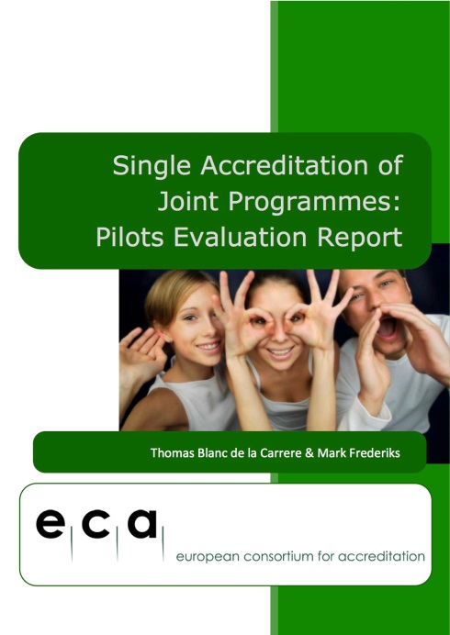
ECA reports on joint programmes

Slide 45
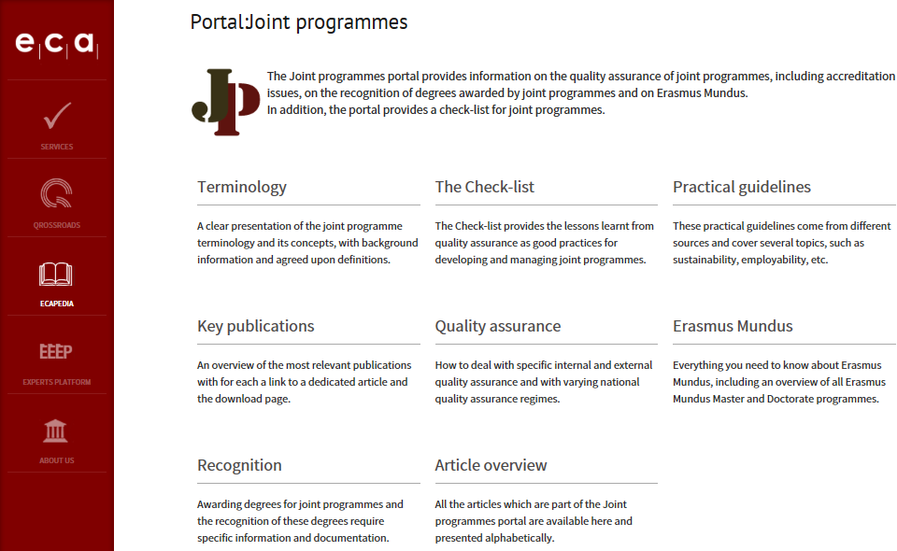
ecahe.eu/w/index.php/Portal:Joint_programmes

Slide 46
Thank you for your attention
ecahe.eu +31 70 312 2352
secretariat@ecahe.eu
@ECA_Association
ECA

